Slide 1
Mobile Robot Kinematics
Localization
"Position"
Cognition
Global Map
Environment Model
Path
Local Map
Perception
Real World
Motion Control
Environment
Requirements for Motion Control

Slide 2
Introduction: Mobile Robot Kinematics
Aim
Description of mechanical behavior of the robot for design and control
Similar to robot manipulator kinematics
However, mobile robots can move unbound with respect to its environment
There is no direct way to measure the robot’s position
Position must be integrated over time
Leads to inaccuracies of the position (motion) estimate -> the number 1 challenge in mobile robotics
Understanding mobile robot motion starts with understanding wheel constraints placed on the robots mobility

Slide 3
Introduction: Kinematics Model
Goal:
establish the robot speed as a function of the wheel speeds , steering angles , steering speeds and the geometric parameters of the robot (configuration coordinates).
forward kinematics
Inverse kinematics
why not
-> not straight forward

Slide 4
Representing Robot Position
Representing the robot within an arbitrary initial frame
Initial frame or Reference Frame :
Robot frame:
Robot position:
Mapping between the two frames
the orthogonal rotation matrix:
Notes:
http://en.wikipedia.org/wiki/Rotation_matrix

Slide 5
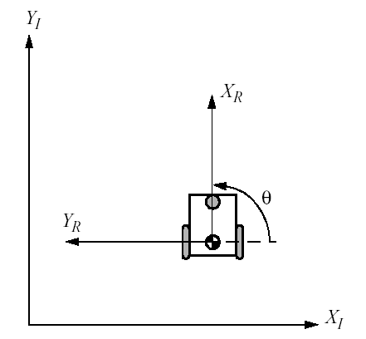
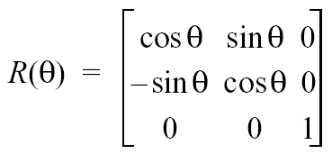
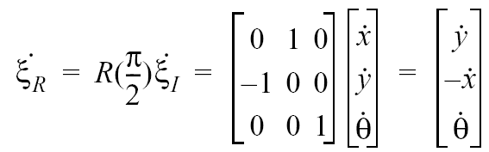
Example: Robot aligned with Y_{I}

Slide 6
Wheel Kinematic Constraints: Assumptions
Movement on a horizontal plane
Point contact of the wheels
Wheels not deformable *
Pure rolling
v_{c} = 0 at contact point
No slipping, skidding or sliding
No friction for rotation around contact point
Steering axes orthogonal to the surface
Wheels connected by rigid frame (chassis)
* http://www.youtube.com/watch?v=mfJejgODr3E
Notes:
Slip - slide unintentionally for a short distance, typically losing one's balance or footing
Skid - slide, typically sideways or obliquely (slantwise), on slippery ground or as a result of stopping or turning too quickly
Slide - move (something) along a surface while maintaining continuous contact with it.
http://www.youtube.com/watch?v=mfJejgODr3E

Slide 7
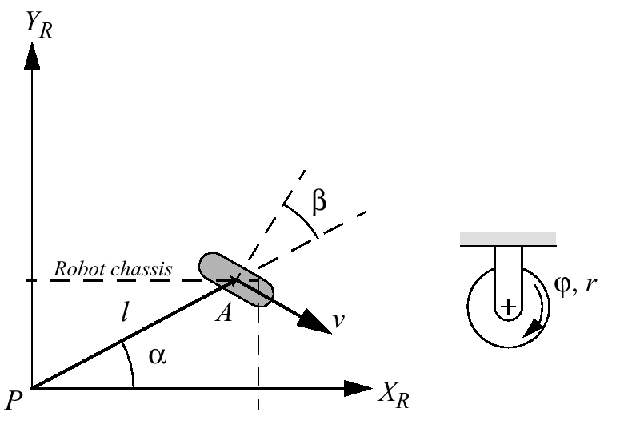
Wheel Kinematic Constraints: Fixed Standard Wheel
.
y
.
θ
.
x
Notes:
Example:
For example, suppose that wheel A is in a position such that α=0, β=0.
This would place the contact point of the wheel on X_{I} with the plane of the wheel oriented parallel to Y_{I}. If θ=0 then sliding constraint (3.6) reduces to:

Slide 8
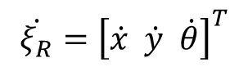
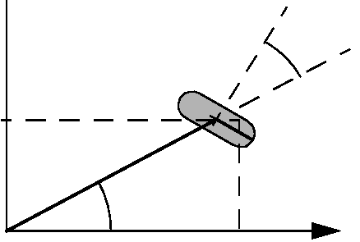
.
θ (−l)
β
.
.
θ (−l) cos(β)
θ l sin(β)
Robot chassis
.
.
v = r ϕ
A
x cos(α+β)
l
.
θ
α
.
(α+β)
x
.
.
y (-cos(α+β))
y sin(α+β)
.
(α+β)
x sin(α+β)
$$\dot{ξ_{R}}={\left[\dot{x} \dot{y} \dot{θ}\right]}^{T}$$
.
y
$$\left[\sin\left(α+β\right) −\cos\left(α+β\right) \left(−l\right)\cos{β}\right]R\left(θ\right)\dot{ξ_{I}}−r\dot{φ}=0$$
$$\left[\cos\left(α+β\right) \sin\left(α+β\right) l\sin{β}\right]R\left(θ\right)\dot{ξ_{I}} =0$$
Notes:
Example:
For example, suppose that wheel A is in a position such that α=0, β=0.
This would place the contact point of the wheel on X_{I} with the plane of the wheel oriented parallel to Y_{I}. If θ=0 then sliding constraint (3.6) reduces to:

Slide 9
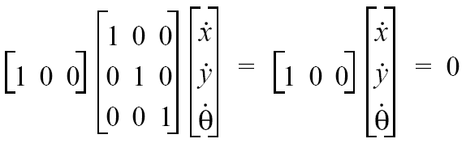
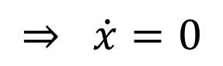
Example
$$\left[\sin\left(α+β\right) −\cos\left(α+β\right) \left(−l\right)\cos{β}\right]R\left(θ\right)\dot{ξ_{I}}−r\dot{φ}=0$$
$$\left[\cos\left(α+β\right) \sin\left(α+β\right) l\sin{β}\right]R\left(θ\right)\dot{ξ_{I}} =0$$
Suppose that the wheel A is in position such that α = 0 and β = 0
This would place the contact point of the wheel on X_{I} with the plane of the wheel oriented parallel to Y_{I}. If θ = 0, then the sliding constraint reduces to:
$$⇒ \dot{x}=0$$

Slide 10
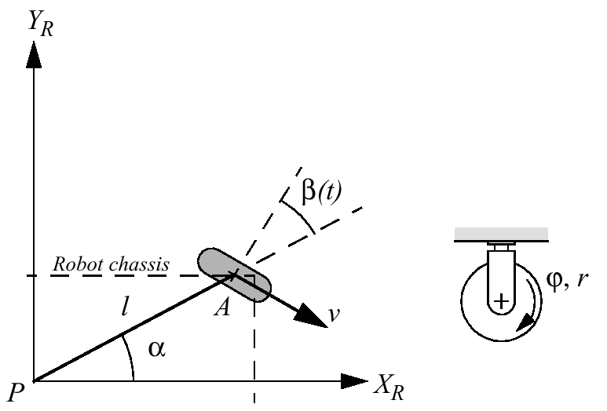
Wheel Kinematic Constraints: Steered Standard Wheel
$$\left[\sin\left(α+β\left(t\right)\right) −\cos\left(α+β\left(t\right)\right) \left(−l\right)\cos{β\left(t\right)}\right]R\left(θ\right)\dot{ξ_{I}}−r\dot{φ}=0$$
$$\left[\cos\left(α+β\left(t\right)\right) \sin\left(α+β\left(t\right)\right) l\sin{β\left(t\right)}\right]R\left(θ\right)\dot{ξ_{I}} =0$$
Notes:
$\dot{β }$does not have a direct impact on the instantaneous motion constraints of a robot. It is
only by integrating over time that changes in steering angle can affect the mobility of a
vehicle.

Slide 11
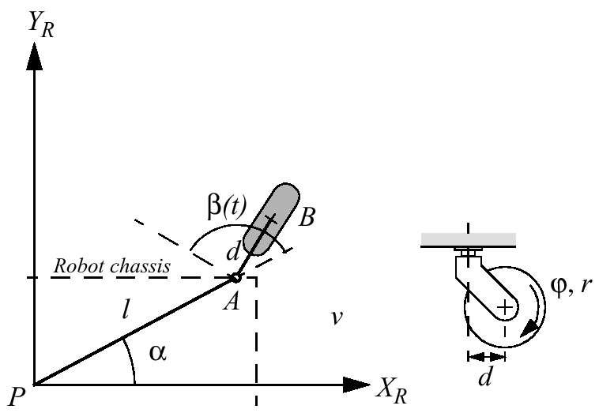
Wheel Kinematic Constraints: Castor Wheel

Slide 12
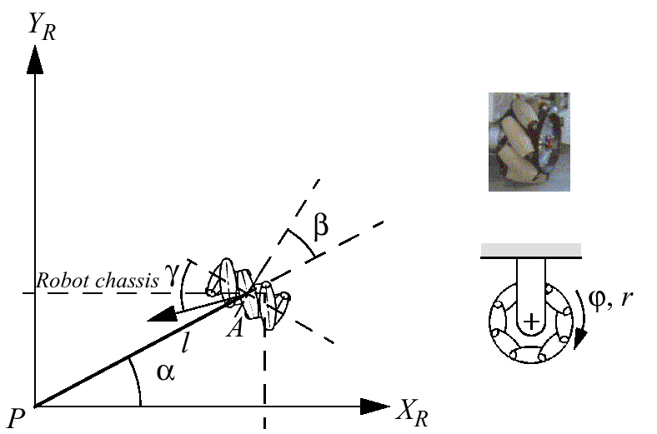
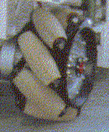
Wheel Kinematic Constraints: Swedish Wheel
Notes:
Example:
γ = 0: Swedish wheel with 90° -> decoupled
γ = π ⁄ 2: Swedish wheel with 45°

Slide 13
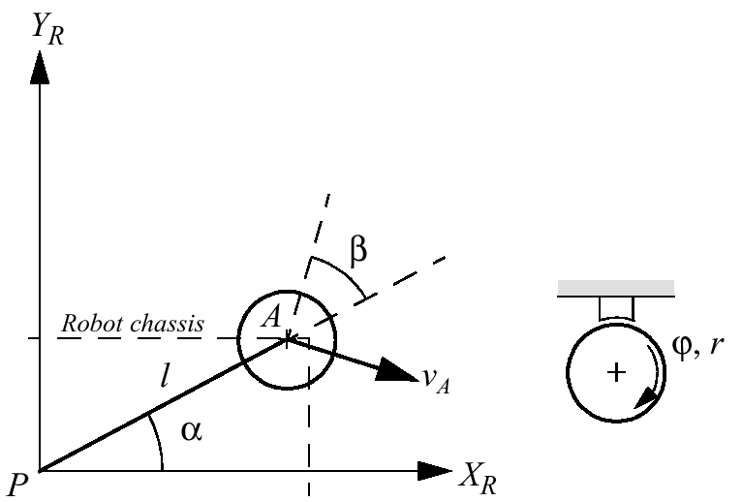
Wheel Kinematic Constraints: Spherical Wheel
Rotational axis of the wheel can have an arbitrary direction
Notes:
Where β is free variable deductible from equation 2
Example:
Consider the case that the robot is in pure translation in the direction of Y_{R}. Then equation (3.15) reduces to sin(α+β)=0, thus β=0 which makes perfect sense for this special case

Slide 14
Robot Kinematic Constraints
25.2.2008 – after 1st hour
Given a robot with M wheels
each wheel imposes zero or more constraints on the robot motion
only fixed and steerable standard wheels impose constraints
What is the maneuverability of a robot considering a combination of different wheels?
Suppose we have a total of N=N_{f} + N_{s} standard wheels
We can develop the equations for the constraints in matrix forms:
Rolling
Lateral movement
-

Slide 15
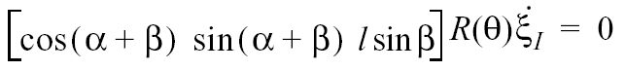
Example: Differential Drive Robot
Presented on blackboard

Slide 16
Example: Omnidirectional Robot
Presented on blackboard

Slide 17
Mobile Robot Maneuverability
The maneuverability of a mobile robot is the combination
of the mobility available based on the sliding constraints
plus additional freedom contributed by the steering
Three wheels is sufficient for static stability
additional wheels need to be synchronized
this is also the case for some arrangements with three wheels
It can be derived using the equation seen before
Degree of mobility
Degree of steerability
Robots maneuverability

Slide 18
Mobile Robot Maneuverability: Degree of Mobility
To avoid any lateral slip the motion vector has to satisfy the following constraints:
Mathematically:
must belong to the null space of the projection matrix
Null space of is the space N such that for any vector n in N
Geometrically this can be shown by the Instantaneous Center of Rotation (ICR)
Notes:
homogeneous

Slide 19
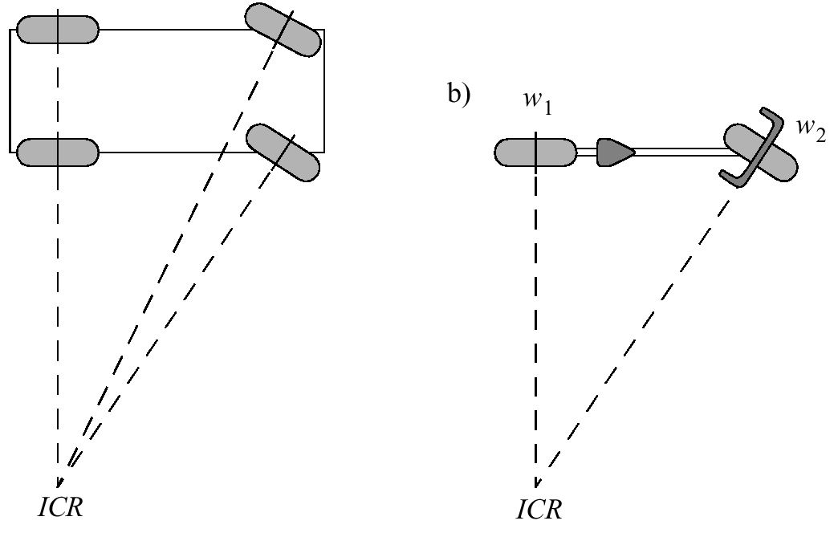
Mobile Robot Maneuverability: Instantaneous Center of Rotation
Ackermann Steering Bicycle

Slide 20
Mobile Robot Maneuverability: More on Degree of Mobility
Robot chassis kinematics is a function of the set of independent constraints
the greater the rank of , the more constrained is the mobility
Mathematically
no standard wheels
all direction constrained
Examples:
Unicycle: One single fixed standard wheel
Differential drive: Two fixed standard wheels
wheels on same axle
wheels on different axle

Slide 21
Mobile Robot Maneuverability: Degree of Steerability
Indirect degree of motion
The particular orientation at any instant imposes a kinematic constraint
However, the ability to change that orientation can lead additional degree of maneuverability
Range of :
Examples:
one steered wheel: Tricycle
two steered wheels: No fixed standard wheel
car (Ackermann steering): N_{f} = 2, N_{s}=2 ➔ common axle

Slide 22
Mobile Robot Maneuverability: Robot Maneuverability
Degree of Maneuverability
Two robots with same are not necessary equal
Example: Differential drive and Tricycle (next slide)
For any robot with the ICR is always constrained to lie on a line
For any robot with the ICR is not constrained and can be set to any point on the plane
The Synchro Drive example:

Slide 23
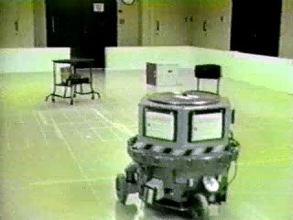
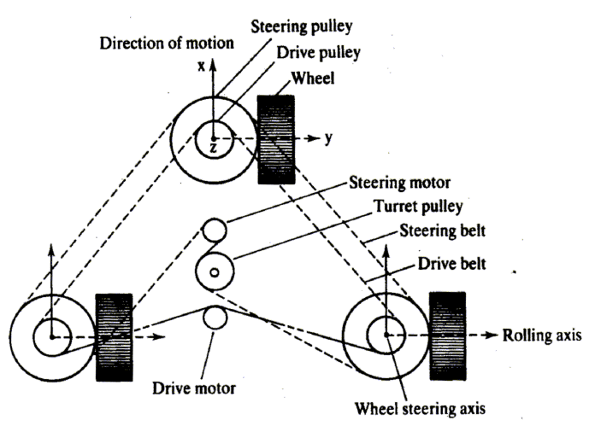
Synchro Drive
Video: J. Borenstein

Slide 24
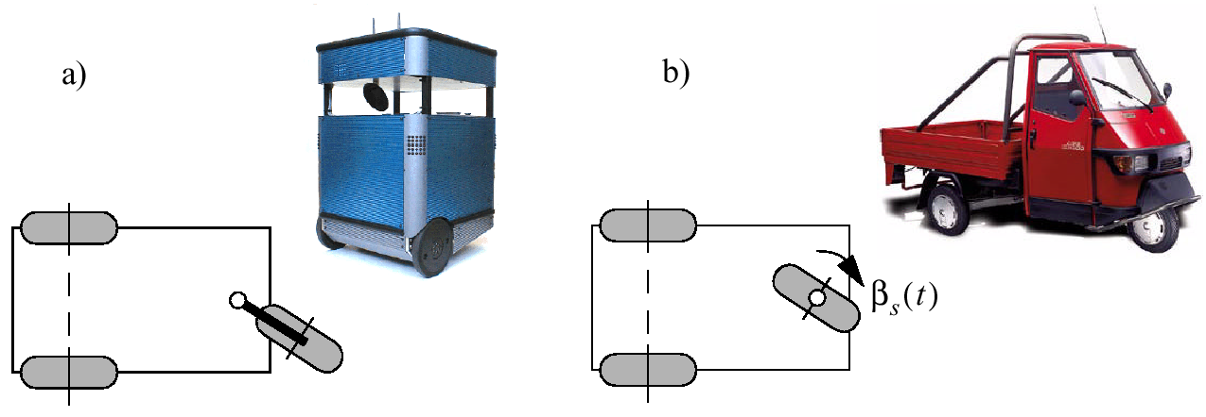
Mobile Robot Maneuverability: Wheel Configurations
Differential Drive Tricycle

Slide 25
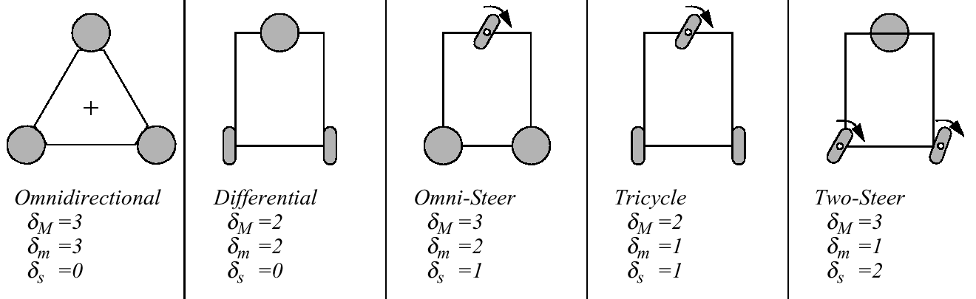
Five Basic Types of Three-Wheel Configurations

Slide 26
Mobile Robot Workspace: Degrees of Freedom
The Degree of Freedom (DOF) is the robot’s ability to achieve various poses.
But what is the degree of vehicle’s freedom in its environment?
Car example
Workspace
how the vehicle is able to move between different configuration in its workspace?
The robot’s independently achievable velocities
= differentiable degrees of freedom (DDOF) =
Bicycle: DDOF = 1; DOF=3
Omni Drive: DDOF=3; DOF=3

Slide 27
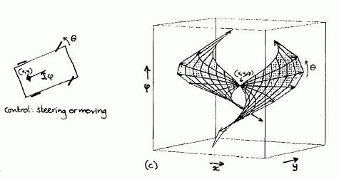
Non-holonomic mobile robot
2D-surface in 3D configuration space

Slide 28
Mobile Robot Workspace: Degrees of Freedom, Holonomy
DOF degrees of freedom:
Robots ability to achieve various poses
DDOF differentiable degrees of freedom:
Robots ability to achieve various path
Holonomic Robots
A holonomic kinematic constraint can be expressed by an explicit function of position variables only
A non-holonomic constraint requires a different relationship, such as the derivative of a position variable
Fixed and steered standard wheels impose non-holonomic constraints

Slide 29
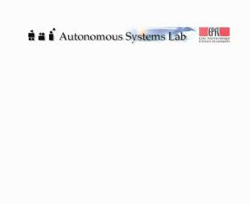
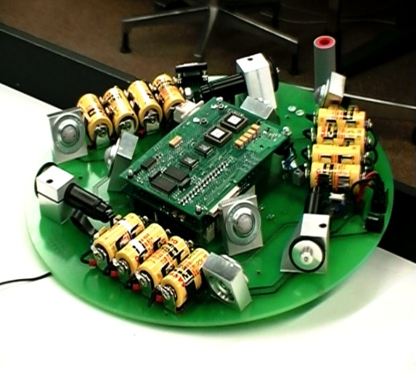
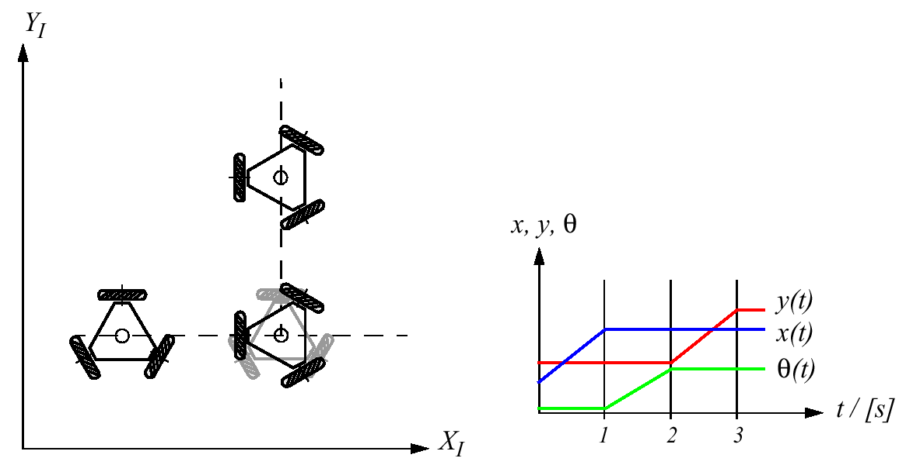
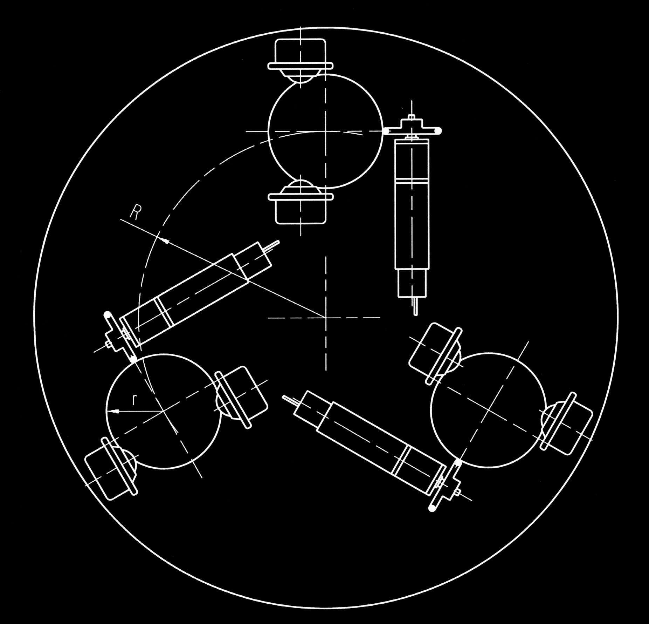
Path / Trajectory Considerations: Omnidirectional Drive
Tribolo ETH/EPFL

Slide 30
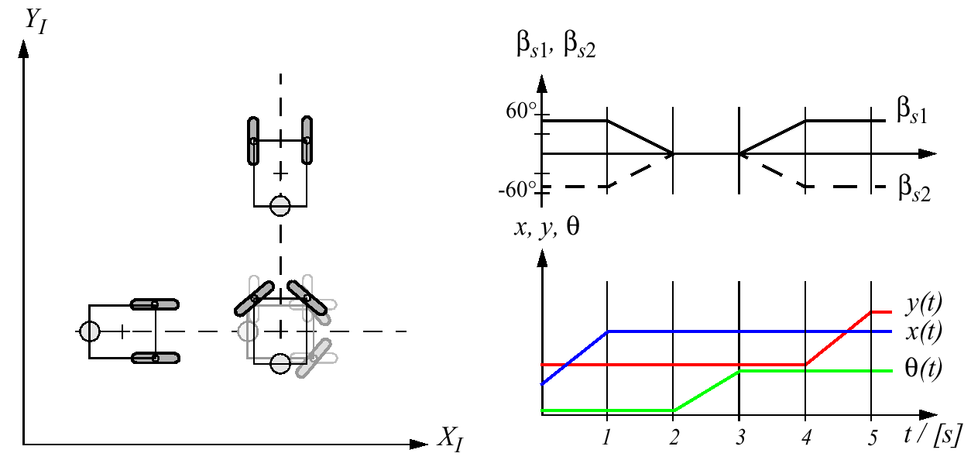
Path / Trajectory Considerations: Two-Steer

Slide 31
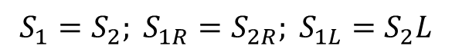
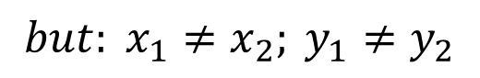
Mobile Robot Kinematics: Non-Holonomic Systems
$$S_{1}=S_{2}; S_{1R}=S_{2R}; S_{1L}=S_{2}L$$
$$but: x_{1}{≠x}_{2}; y_{1}≠y_{2}$$
Non-holonomic systems
differential equations are not integrable to the final position.
the measure of the traveled distance of each wheel is not sufficient to calculate the final position of the robot. One has also to know how this movement was executed as a function of time.

Slide 32
Non-Holonomic Systems: Mathematical Interpretation
A mobile robot is running along a trajectory s(t). At every instant of the movement its velocity v(t) is:
Function v(t) is said to be integrable (holonomic) if there exists a trajectory function s(t) that can be described by the values x, y, and θ only.
This is the case if
With s = s(x,y,θ) we get for ds
Condition for integrable function

Slide 33
Non-Holonomic Systems: The Mobile Robot Example
In the case of a mobile robot where
and by comparing the equation above with
we find
Condition for an integrable (holonomic) function:
the second (-sinθ=0) and third (cosθ=0) term in equation do not hold!

Slide 34
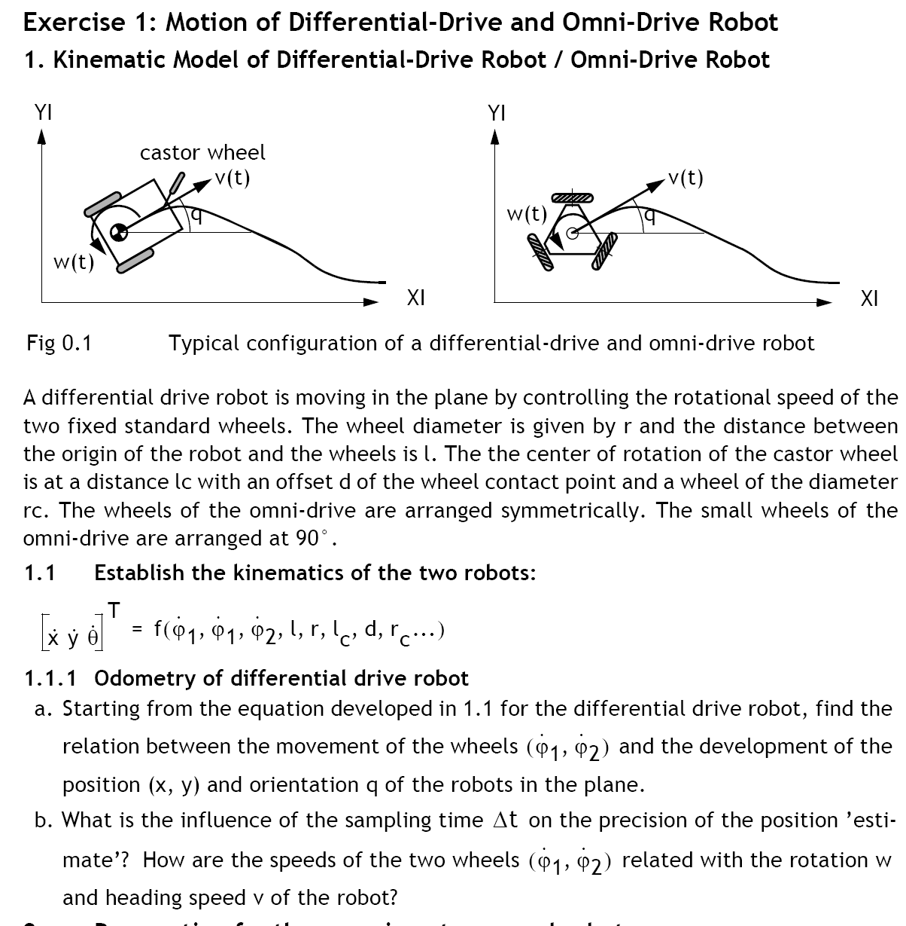
Exercise

Slide 35
Exercise

Slide 36
Exercise – Solutions Geometric Approach

Slide 37
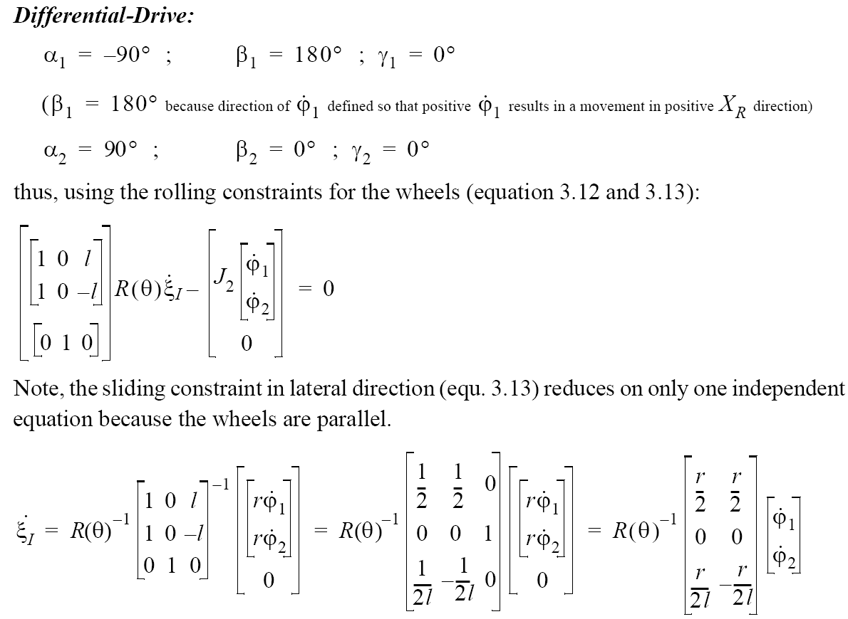
Exercise – Solutions: Using Kinematic Model

Slide 38
Exercise – Solutions Geometric Approach

Slide 39
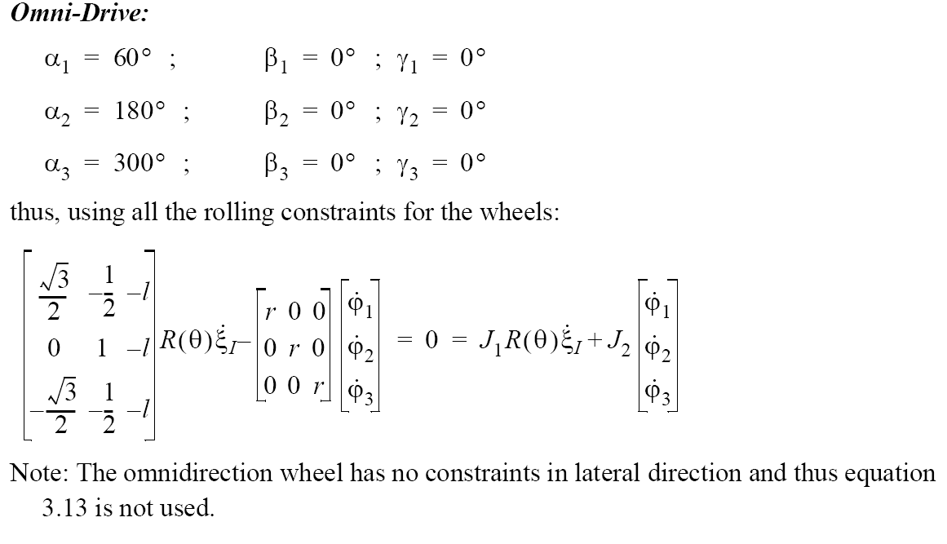
Exercise – Solutions: Using Kinematic Model

Slide 40
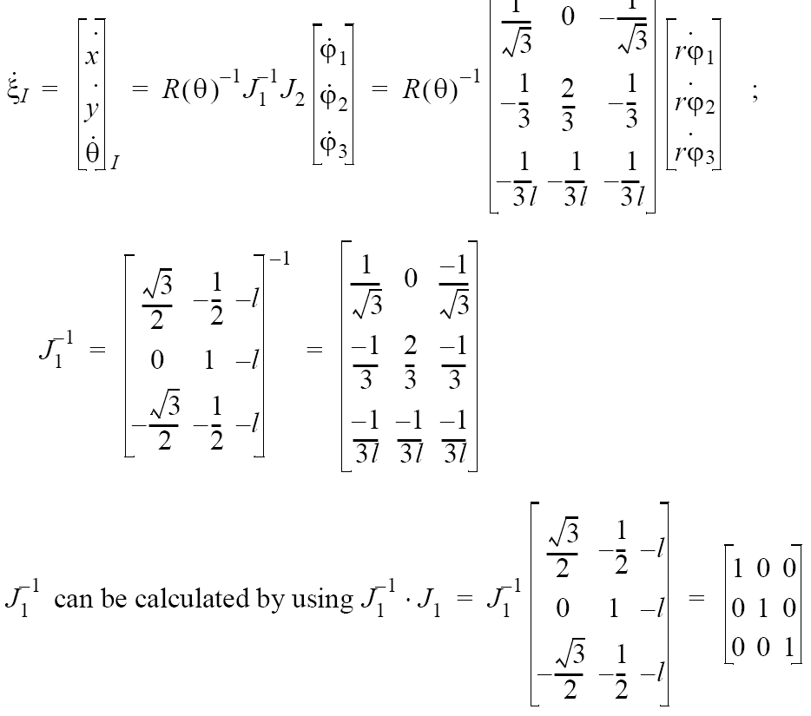
Exercise – Solutions: Using Kinematic Model

Slide 41
Motion Control (wheeled robots)
3
Localization
"Position"
Cognition
Global Map
Environment Model
Path
Local Map
Perception
Real World
Motion Control
Environment
Control law that satisfies the requirements

Slide 42
Motion Control (kinematic control)
The objective of a kinematic controller is to follow a trajectory described by its position and/or velocity profiles as function of time.
Motion control is not straight forward because mobile robots are typically non-holonomic systems.
However, it has been studied by various research groups and some adequate solutions for (kinematic) motion control of a mobile robot system are available.
Most controllers are not considering the dynamics of the system

Slide 43
Motion Control: Open Loop Control
trajectory (path) divided in motion segments of clearly defined shape:
straight lines and segments of a circle.
control problem:
pre-compute a smooth trajectory based on line and circle segments
Disadvantages:
It is not at all an easy task to pre-compute a feasible trajectory
limitations and constraints of the robots velocities and accelerations
does not adapt or correct the trajectory if dynamical changes of the environment occur.
The resulting trajectories are usually not smooth

Slide 44
Motion Control: Feedback Control, Problem Statement
Find a control matrix K, if exists with k_{ij}=k(t,e)
such that the control of v(t) and ω(t)
drives the error e to zero.

Slide 45
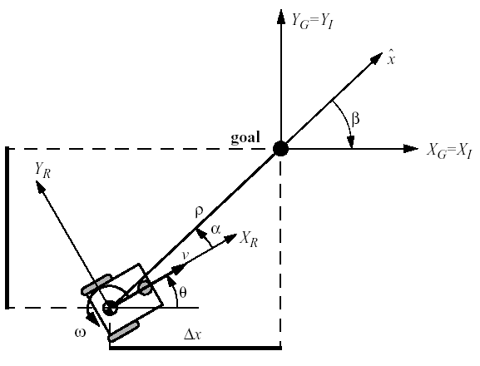
Motion Control: Kinematic Position Control
The kinematics of a differential drive mobile robot described in the initial frame {x_{I}, y_{I}, θ} is given by,
where and are the linear velocities in the direction of the x_{I} and y_{I} of the initial frame.
Let a denote the angle between the x_{R} axis of the robots reference frame and the vector connecting the center of the axle of the wheels with the final position.
Δy

Slide 46
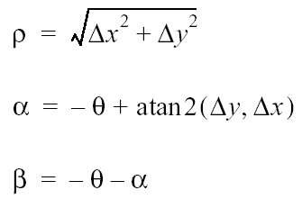
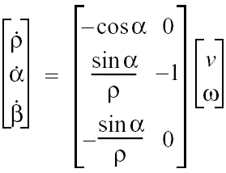
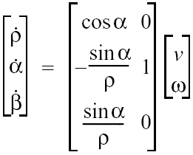
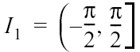
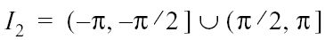
Kinematic Position Control: Coordinates Transformation
Coordinates transformation into polar coordinates with its origin at goal position:
System description, in the new polar coordinates
Δy
for
for

Slide 47
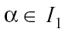
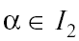
Kinematic Position Control: Remarks
The coordinates transformation is not defined at x = y = 0; as in such a point the determinant of the Jacobian matrix of the transformation is not defined, i.e. it is unbounded
For the forward direction of the robot points toward the goal, for it is the backward direction.
By properly defining the forward direction of the robot at its initial configuration, it is always possible to have at t=0. However this does not mean that α remains in I₁ for all time t.
Δy

Slide 48
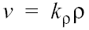
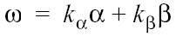
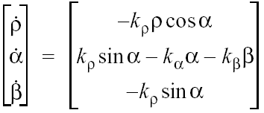
Kinematic Position Control: The Control Law
It can be shown, that with the feedback controlled system will drive the robot to
The control signal v has always constant sign,
the direction of movement is kept positive or negative during movement
parking maneuver is performed always in the most natural way and without ever inverting its motion.

Slide 49
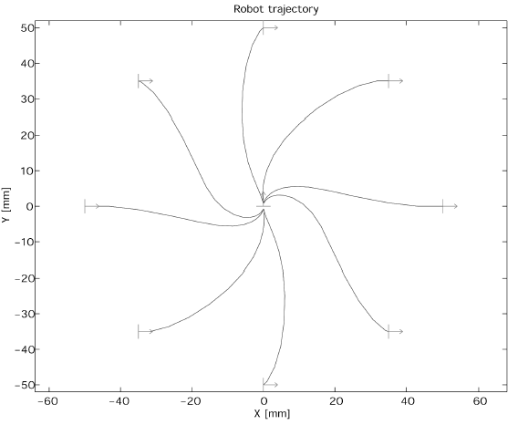
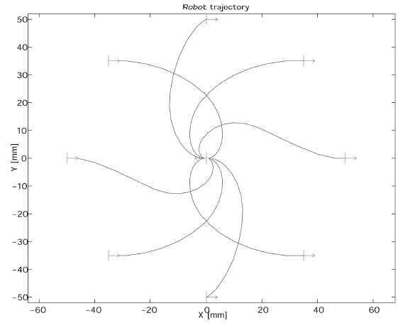
Kinematic Position Control: Resulting Path
The goal is in the center and the initial position on the circle.

Slide 50
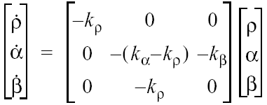
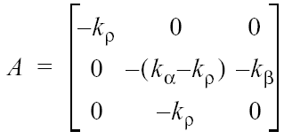
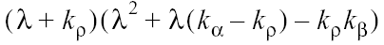
Kinematic Position Control: Stability Issue
It can further be shown, that the closed loop control system is locally exponentially stable if
Proof: for small x −> cosx = 1, sinx = x
and the characteristic polynomial of the matrix A of all roots have negative real parts.

Slide 51
Questions?
Answers

